Slide 1
Big Data overview

Slide 2
Predict in production

Slide 3
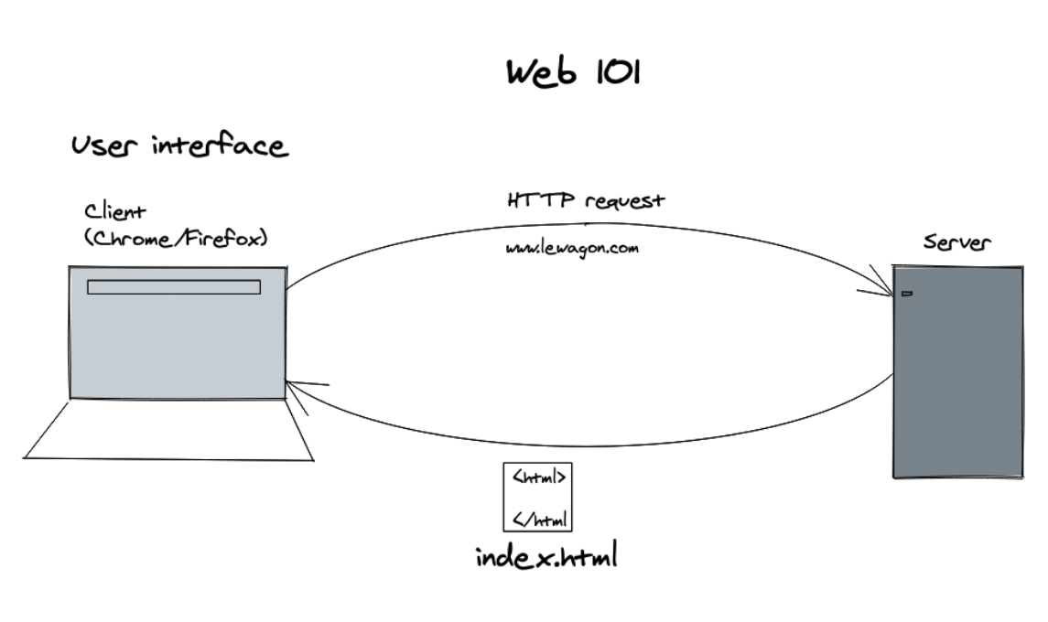
Web 101
How does the web work?

Slide 4
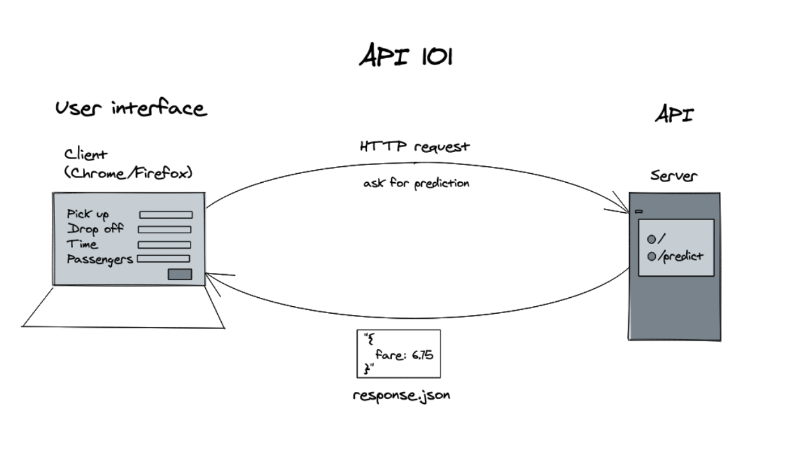
Web 101
How does an API work?
E.g. GitHub's interface for humans vs API

Slide 5

Fast API
High Performance python framework
Easy to learn, fast to code
Automatically generated documentation allowing to test the API endpoints easily
Pip install Fast api
FastAPI documention

Slide 6
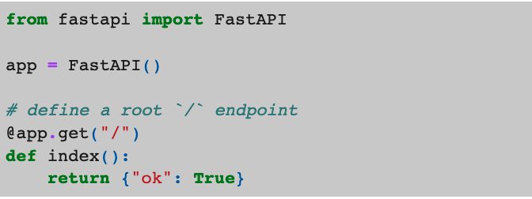
Fast API : Root entry point
FastAPI uses python decorators in order to link the routes that the developers will query to the code of the endpoints.
The code of the decorated function will be called whenever a HTTP request is received.
The response will be returned as a JSON object to the code querying the API.

Slide 7
Fast API : What if we run the code ?
python simple.py
Nothing happens... 🤔
We need to use a web server in order to listen to the web requests for the API and call the code of the corresponding endpoint !
👉 We will use Uvicorn

Slide 8

Uvicorn
Lightning fast web server for python
👉 Uvicorn listens to all the HTTP requests and calls the code decorated for the corresponding FastAPI endpoints.
pip install uvicorn
ℹ️ Uvicorn documentation

Slide 9
Uvicorn : let’s run our API using the web server
Uvicorn requires as parameters the name of the python file to run (here simple.py) as well as the name of the variable inside of the file containing the instance of the FastAPI app (here the variable is called app, hence the supplied parameter simple:app).
uvicorn simple:app --reload
Now we can browse to the root page of the API: http://localhost:8000/

Slide 10
Uvicorn : documentation and tests
FastAPI provides automatically generated documentation allowing developers to simplify their integration of the API. The endpoints of the API can be easily tested through dedicated pages 🎉
Swagger documentation and tests:
http://localhost:8000/docs
Redoc documentation:
http://localhost:8000/redoc
👉 The /docs endpoint is powered by Swagger and comes in very handy in order to test our API and verify that everything is working correctly. It is also very useful for developers wanting to test our API
/

Slide 11
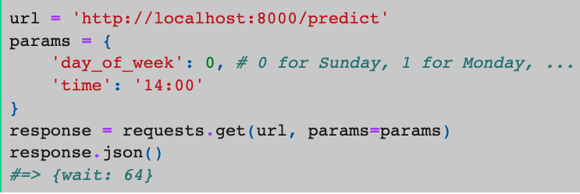
Prediction API use case
We want to build an API to ask for a prediction. For example, how long (in minutes) is the queue at the entry of the Louvre museum for a given week day and time. To do so, our API should be able to accept a HTTP request with params:
The requests.get(url, params=params) results in the HTTP request:
👉 http://localhost:8000/predict?day_of_week=0&time=14:00
ℹ️ ?day_of_week=0&time=14:00 is called a query string.
/

Slide 12
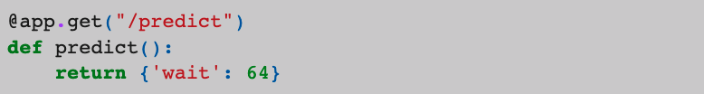
/predict endpoint
Let's add a /predict endpoint to our API

Slide 13
Query parameters
? What if you want to pass parameters to the endpoint ?

Slide 14
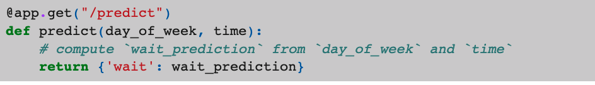
Query parameters
❓What if you want to pass parameters to the endpoint?
FastAPI provides a simple way to do so. You just need need to define the parameters you want to pass as the function parameters.

Slide 15
Query parameters
❓What if you want to pass parameters to the endpoint?
FastAPI provides a simple way to do so. You just need need to define the parameters you want to pass as the function parameters.
⚠️ Query parameters are all str so you will need to deal with their conversions into the suitable data types!

Slide 16
What now
We want to enable any developer writing code on a remote machine connected to the Internet to interact with our program.
Now that we are able to run our API on our machine, how can we push it to production ?

Slide 17
Platform types
Choosing a production medium
Let's make our models available to the world 🌍
We will provide our predictions through:
an API, for developers 🤖
a website, for regular users 🙂

Slide 18
Platform types : serving our predictions
We need:
A web server in order to respond to the API calls
One or more machines to run that web server
A reliable and scalable solution

Slide 19
Platform types : serving our predictions
We need:
A web server in order to respond to the API calls
One or more machines to run that web server
A reliable and scalable solution

Slide 20
Platform types : our choices
Our machine:
❌ is not visible on the Internet, is not up all day all week all year
Google Colab & AI Platform:
❌ do not allow to run web servers

Slide 21
Platform types : our choices
On premise:
❌ we do not want to handle the infrastructure (the network and the hardware)
Infrastructure as a Service (IaaS):
❌ we do not want to setup the platform (operating system) and the environment (python)

Slide 22
Platform types : our choices
Best of both worlds
👉 We want the flexibility of IaaS
👉 Without having to bother with the complexity of its configuration
Solution: containers 🚀

Slide 23
Virtualization
Virtualization is the process of running a virtual instance of a computer system in a layer abstracted from the actual hardware.
It refers to running multiple operating systems on a computer system simultaneously
To the applications running on top of the virtualized machine, it can appear as if they are on their own dedicated machine, where the operating system, libraries, and other programs are unique to the guest virtualized system and unconnected to the host operating system which sits below it

Slide 24
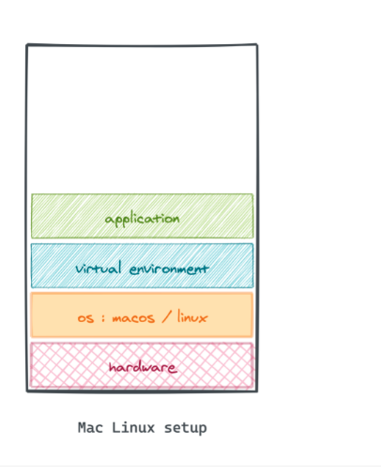
Mac Linux setup abstraction layers

Slide 25
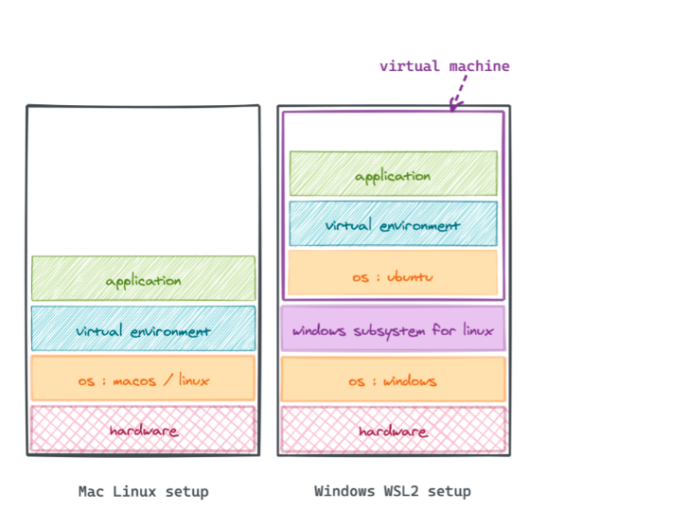
Mac Linux setup abstraction layers

Slide 26
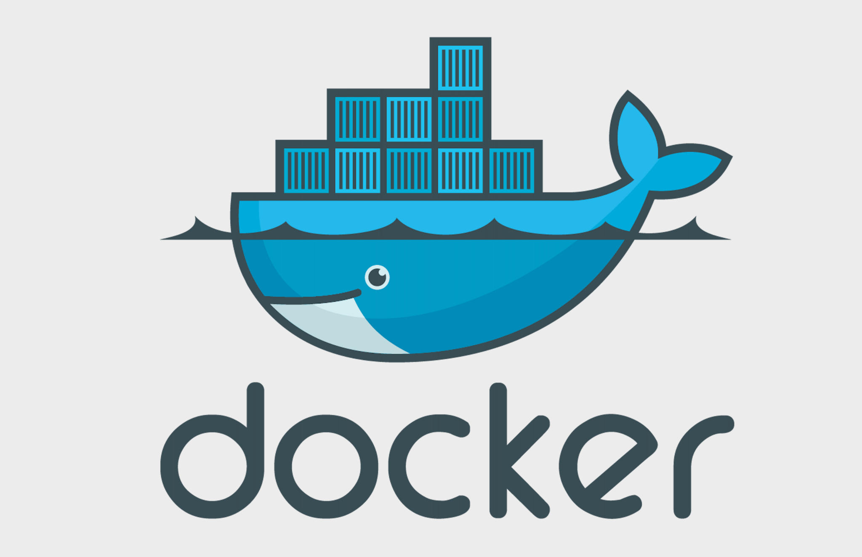
Docker
👉 De facto standard for handling containers in production
👉 Allows to create matching environments for development, testing, QA, and production
👉 Leverages OS-level virtualization

Slide 27
What is a container ?
A container is an encapsulated environment that runs an application.
Running our code inside of a container allows us to deploy it on any machine, without having to know anything about the machine.
Inside of a container, we will find :
👉 The running code of our application (a Prediction API for example)
👉 Its environment (python, the required packages, the uvicorn server that serves the API)
👉 The platform it runs on (the operating system)

Slide 28
How are containers built ?
👉 First, we write a Dockerfile for our application
The Dockerfile is a blueprint describing the steps required in order to create a Docker image.
👉 Then, from the Dockerfile, we build a Docker image
The Docker image is a mold allowing to create containers. The Docker image bundles together the code of our application, its environment and the platform required in order to run it.
👉 Finally, from the Docker image, we can deploy (instantiate) as many containers as we wish. Each container will host a running copy of our application
The Container is an running instance of our code.

Slide 29
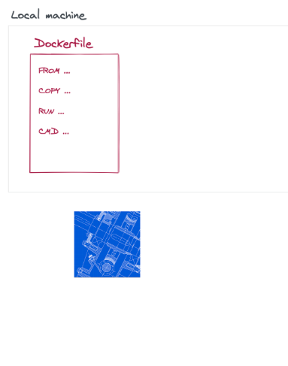
Dockerfile
The Dockerfile is a document that lists all the commands that a user would run in order to build a Docker image.
You can see the Dockerfile as a blueprint for a layer cake mold.

Slide 30
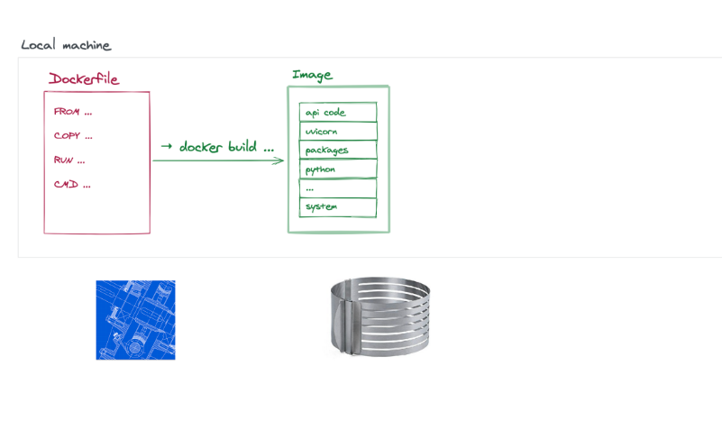
Docker Image
The Docker image holds all the files required in order to instantiate a Docker container.
You can see the Docker image as a layer cake mold.

Slide 31
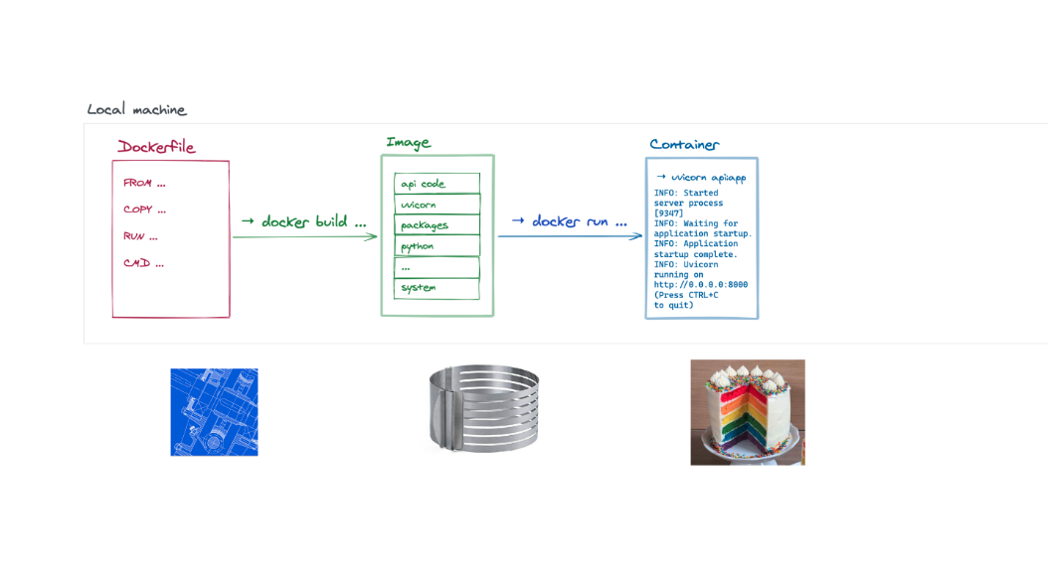
Docker Image
The Docker container hosts a running instance of your code.
You can see the Docker container as a layer cake.

Slide 32
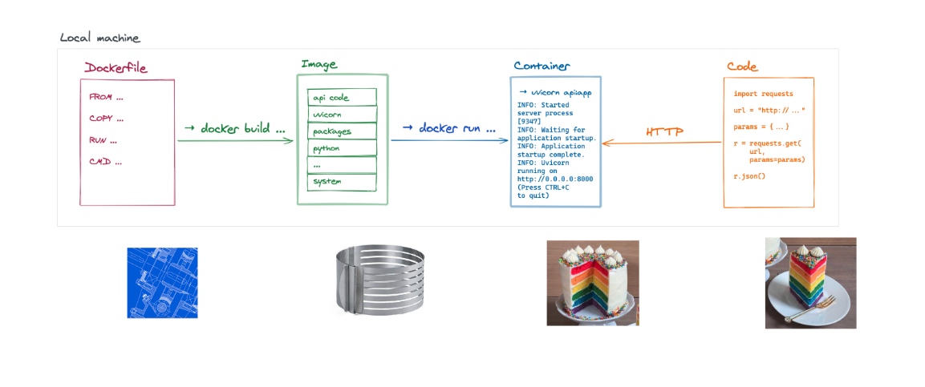
Consumer
Our application will be consumed in different ways depending on its nature. A website will be consumed through a browser. An API will be consumed through code.
You can see the consumer of the application as receiving a piece of the layer cake.

Slide 33

Create a docker image
FROM directive
The FROM directive allows to select the base layer of our image. The base layer or image can range from a naked operating system to a fully configured platform.
Docker Hub hosts the base images maintained by the community. It is the GitHub of Docker images. Let's search for python images.

Slide 34
Build your first image
1.Build a docker image
👉 based on the Dockerfile placed in the current directory .
docker build .
2. List the docker images on the machine
docker images
3. Run the image
👉 see how by default the name of the image corresponds to the FROM directive
docker run python:3.8.6-buster
👉 nothing happens... 🤔

Slide 35
Build your first image
4. Let's run our image interactively -it and ask it to run a shell command sh
👉 this way we can inspect the content of our container 🔎
docker run -it python:3.8.6-buster sh
We get a shell running inside of the container 🤯
We can run any commands. For example we check the installed version of python:
ls -la
python --version
👉 but our app is nowhere to be seen 🤔
Let's exit the container:
exit

Slide 36
Copy directive
Once the base layer of the image is specified, the COPY directive allows to fill the content of the image.
requirements.txt:
fastapi
uvicorn

Slide 37
Build your first image
1. Build our new image
👉 name it api -t api
docker build -t api .
2. List the images
👉 see how the new image now has a different IMAGE ID from the one of the image of the FROM directive
3. Run it interactively
docker run -it api sh

Slide 38
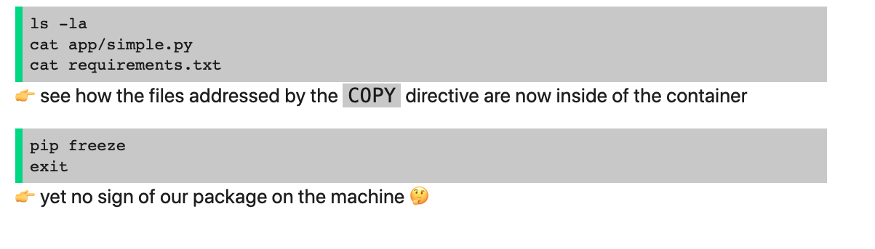
Build your first image
4. Let's see how our app is doing

Slide 39
Build your first image
The RUN directive allows to specify commands that will be executed inside of the image. This might come in handy in order to install the requirements of our packages.

Slide 40

Build your first image
Let's install our packages
1. Build the latest version of the image
👉 you know the drill
2. Run our container interactively
3. Everything seems to be ok... Let's run our container!
👉 aw... 🤔

Slide 41
Build your first image
CMD directive
The CMD directive is the last directive of the Dockerfile. It allows to specify which command the container should run once it has started.
CMD uvicorn app.simple:app --host 0.0.0.0
⚠️ The --host 0.0.0.0 uvicorn parameter tells uvicorn to listen to all the network connexions inside of the container. Without this parameter you will not be able to contact your API through uvicorn.

Slide 42
Build your first image
Finally let's connect to our running container
1. Run the container
docker run -p 8080:8000 api # ⚠️ beware to the order of these parameters or you will get a weird error
👉 Parameters:
-p 8080:8000 maps the 8080 port on your machine to the 8000 port inside of the container
Why 8080? The value does not matter as long as it is within the [0, 65535] range and as long as no application on your machine is already using it
Why 8000? It is the default port used by Uvicorn (you may change it with the --port 1234 parameter)
2. Connect to our API
http://localhost:8080/

Slide 43
Stop a container
1. List the running containers
docker ps
2. Stop the image
👉 use the correct CONTAINER ID
docker stop 152e5b79177b
3. If you are in a hurry
👉 use with caution, only if the image refuses to stop
docker kill 152e5b79177b

Slide 44
Stop a container
1. List the running containers
docker ps
2. Stop the image
👉 use the correct CONTAINER ID
docker stop 152e5b79177b
3. If you are in a hurry
👉 use with caution, only if the image refuses to stop
docker kill 152e5b79177b

